Slide 1
CSE 111 Checkpoint I
Course Stats for UC Merced

Slide 2
Project Overview
The goal is to simplify UC Merced students’ life by showing them relevant data that would help with scheduling classes
Students have trouble scheduling classes because they don’t which course section would be the best for them
With this, students would be able to see what Professors are rated well, what their grading scales are, what textbooks are used, and what their class timings are
Additionally, students will be able to take actions on these courses; they’ll be able to add and delete courses from their personal schedule. This personal schedule will display what classes they have currently added.
Notes:
k

Slide 3
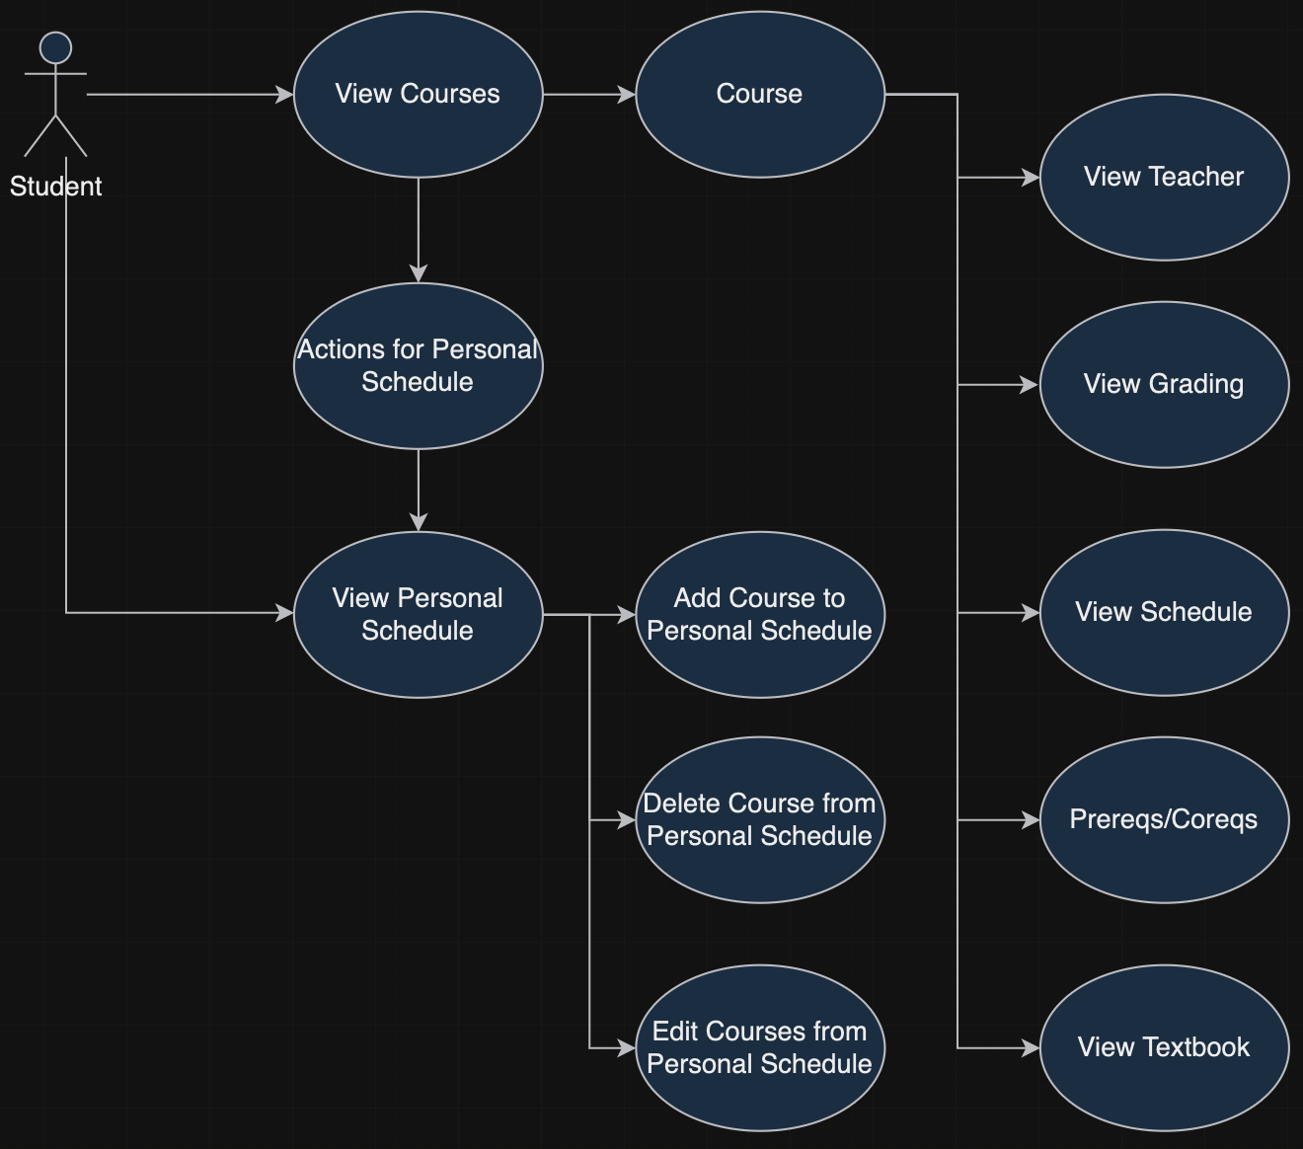
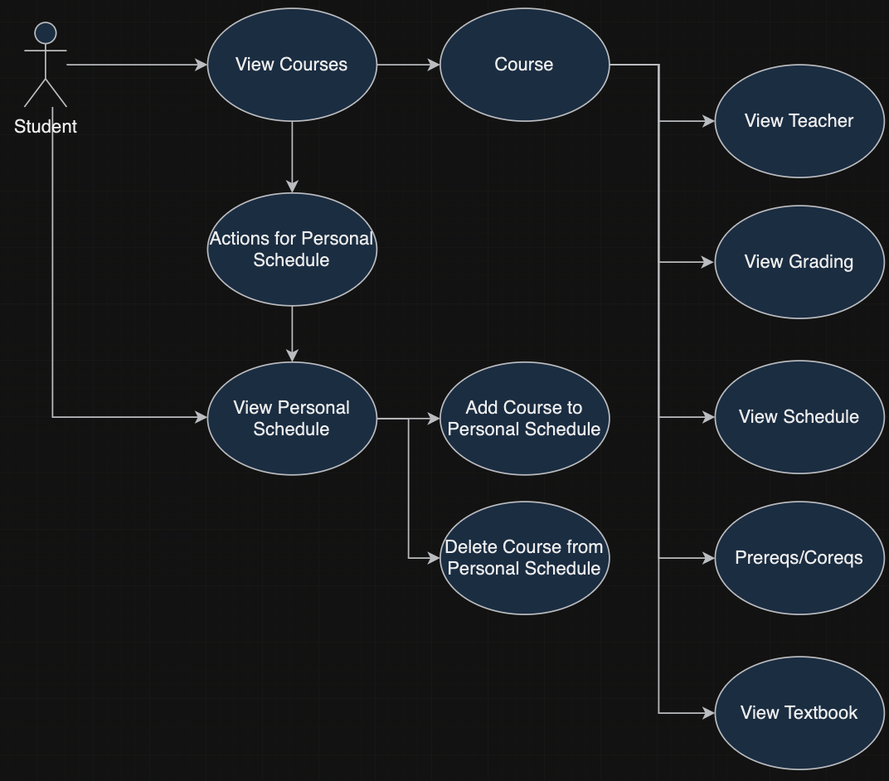
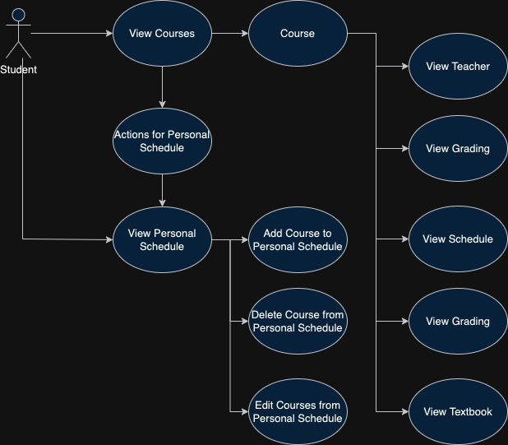
Use-Case Diagram
Notes:
k

Slide 4
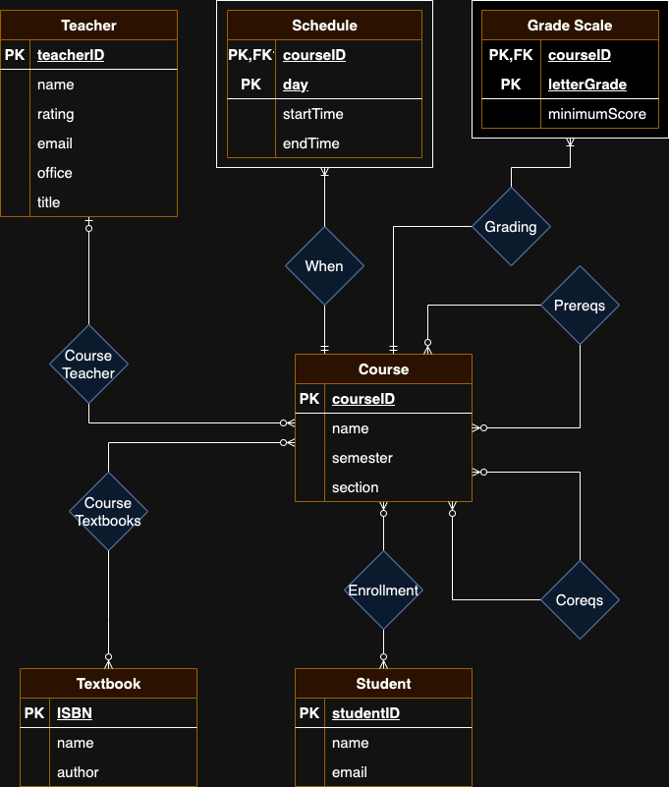
E/R Diagram
Notes:
One teacher per course
One course will have many row in a schedule
One course will have many rows in a grade scale
Course and textbooks have a many to many relationships
Course and students also have a many to many relationship
Prereq and coreqs are many to many tables that relate with other courses.

Slide 5
Relational Schema
Course
- courseID, name, semester, section
Teacher
- teacherID, name, rating, email, office, title
Schedule
- courseID, day, startTime, endTime
Grade Scale
- courseID, letterGrade, minimumScore
Textbook
- ISBN, name, author
Student
- studentID, name, email
Enrollment
- courseID, studentID,
Course Textbooks
- courseID, ISBN
Prereqs
- courseID, prereqID
Coreqs
- courseID, coreqID

Slide 6
Implementation
Database
PostgreSQL
Simple database management system
Frontend/Backend
Budibase
Once data layer is created, makes creation of frontend and backend simpler
Uses low-code visual programming to create the UI
Both the PostgreSQL and Budibase are hosted on Docker
Project Github: https://github.com/Insainian/UCM-Course-Stats
Notes:
k

Slide 7
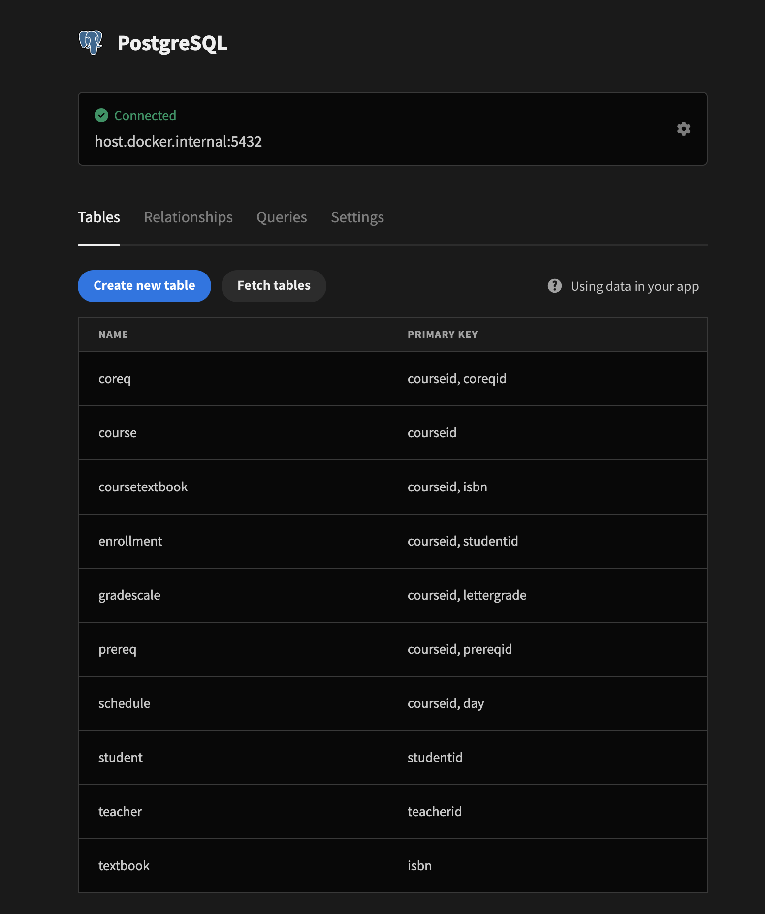
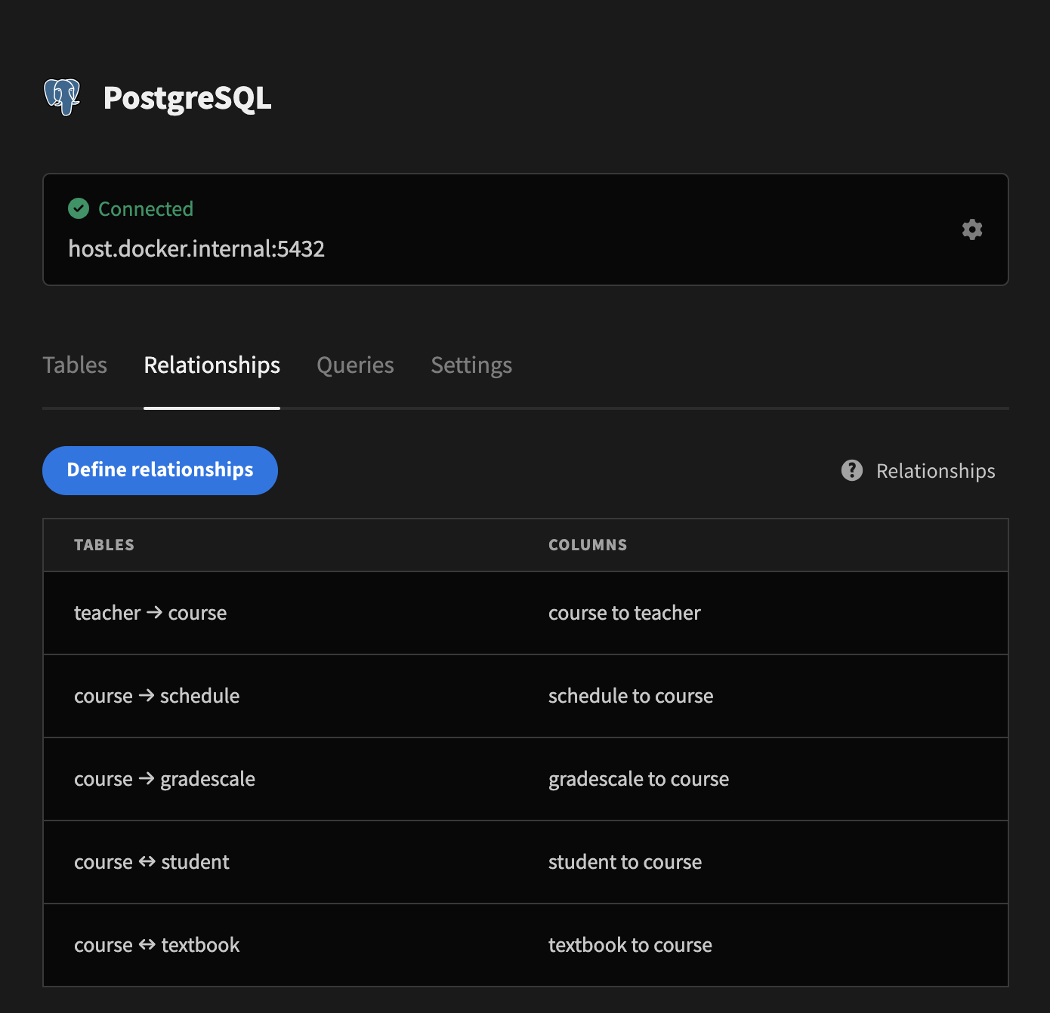

Slide 8
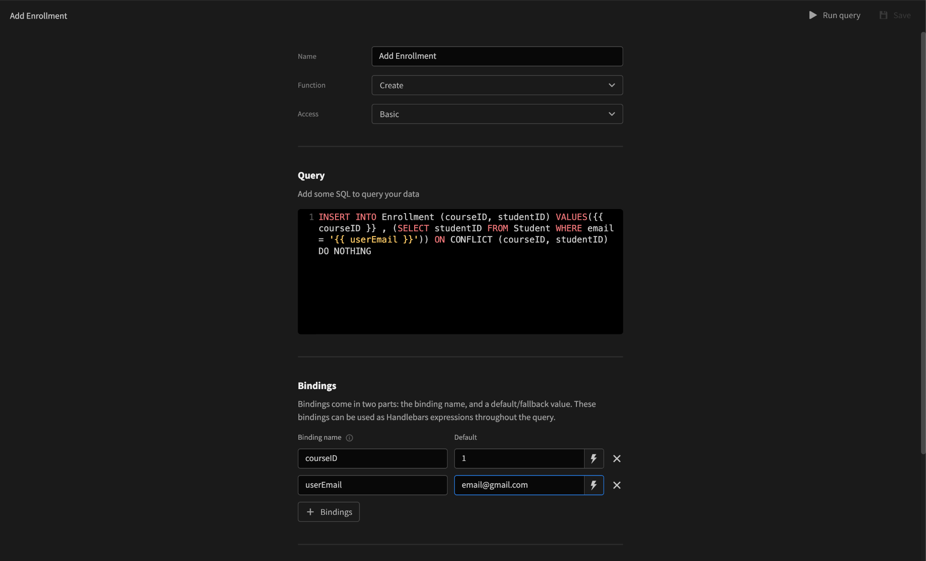

Slide 9
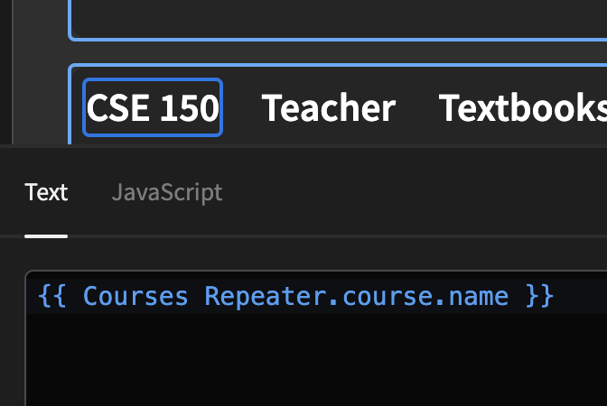
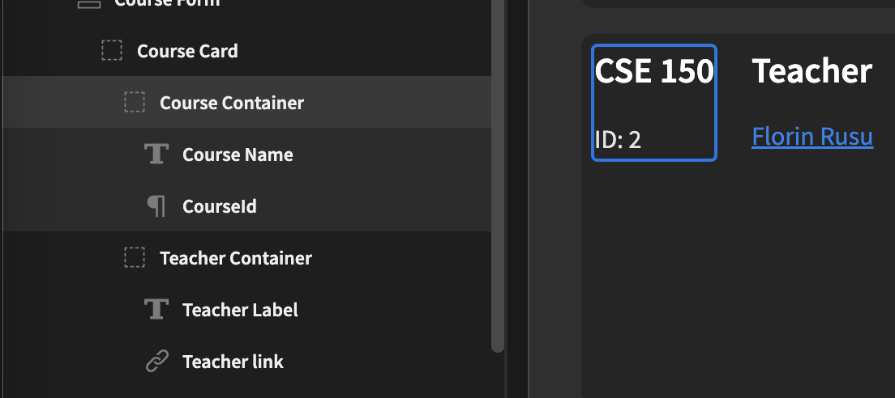

Slide 10
Demo

